Slide 1
Ocean Plastic Pollution
Prepared By: MOHAMED NIKKAS

Slide 2
Introduction :
Plastic pollution is a big problem around the world. Every year, huge amounts of plastic waste go into the oceans, hurting sea animals and the environment. By studying data, we can see where the pollution comes from, which areas are most affected, and how we can take action to protect nature.
Project Objectives :
Analyze ocean plastic pollution trends from 2017–2025.
Identify regions and countries contributing the most to ocean plastic.
Evaluate the relationship between population, waste management, and pollution.
Develop predictive insights for future pollution levels
Data Preprocessing :
Adds a new column “Pollution_Level” to the dataset.
Helps label each region as:
Low → < 100 kg
Moderate → 100–349 kg
High → ≥ 350 kg

Slide 3
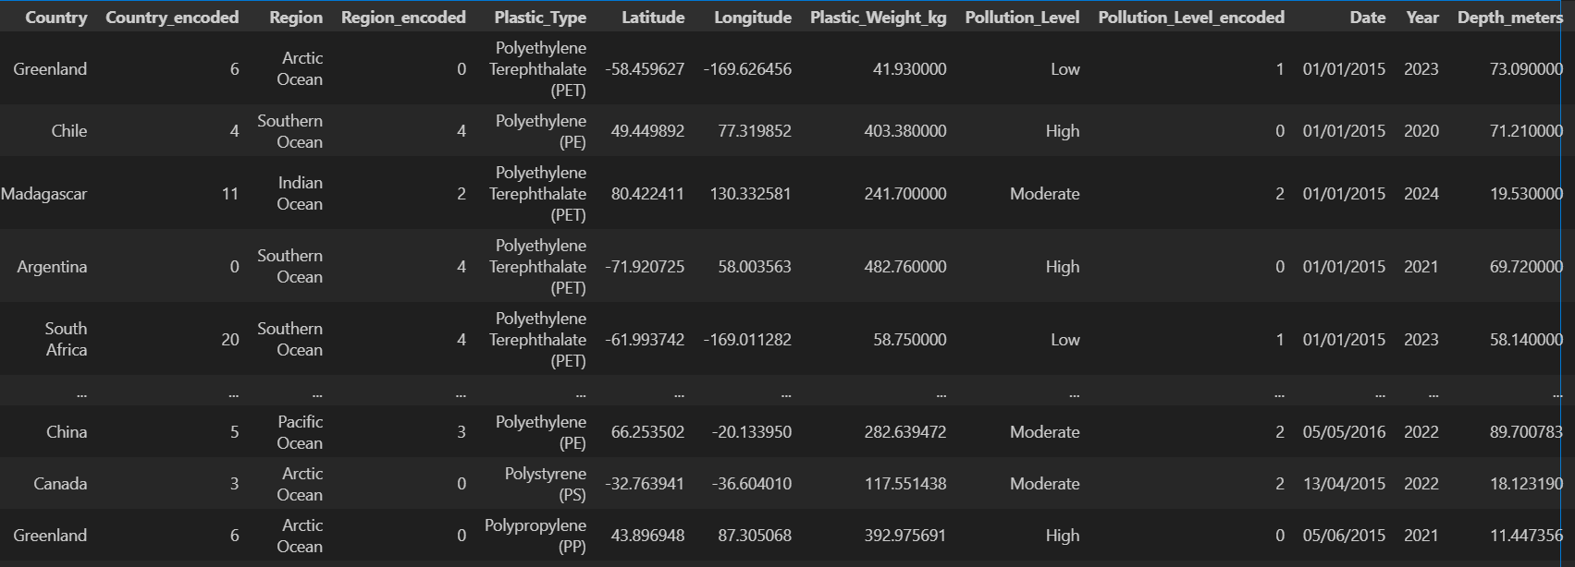
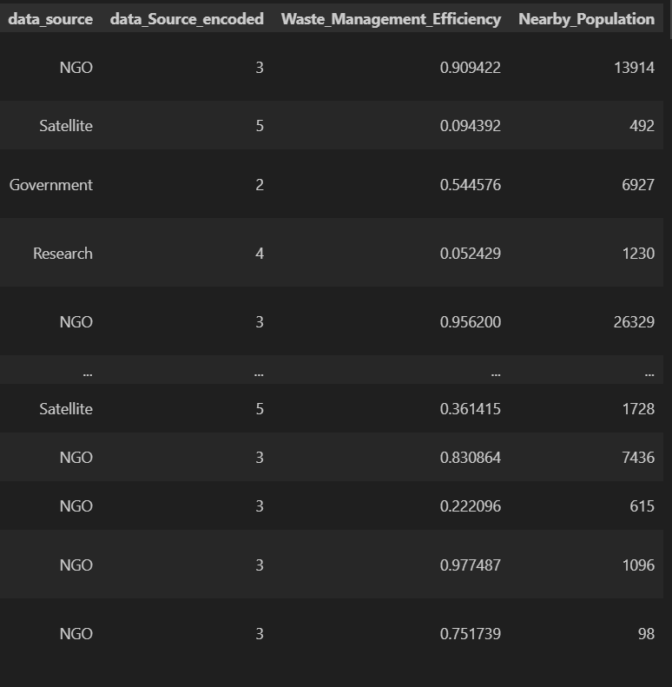
Converts the Date column into a proper datetime type.
Extract Year column form Date column
Fill NaN values with using forward fill
Dataset overview :
Dataset name : ocean plastic pollution
Rows : 115000
It contains Population count near the coastal region.
Indicates how effective waste handling and recycling is in nearby regions.
indicates the year when pollution data was collected.

Slide 4
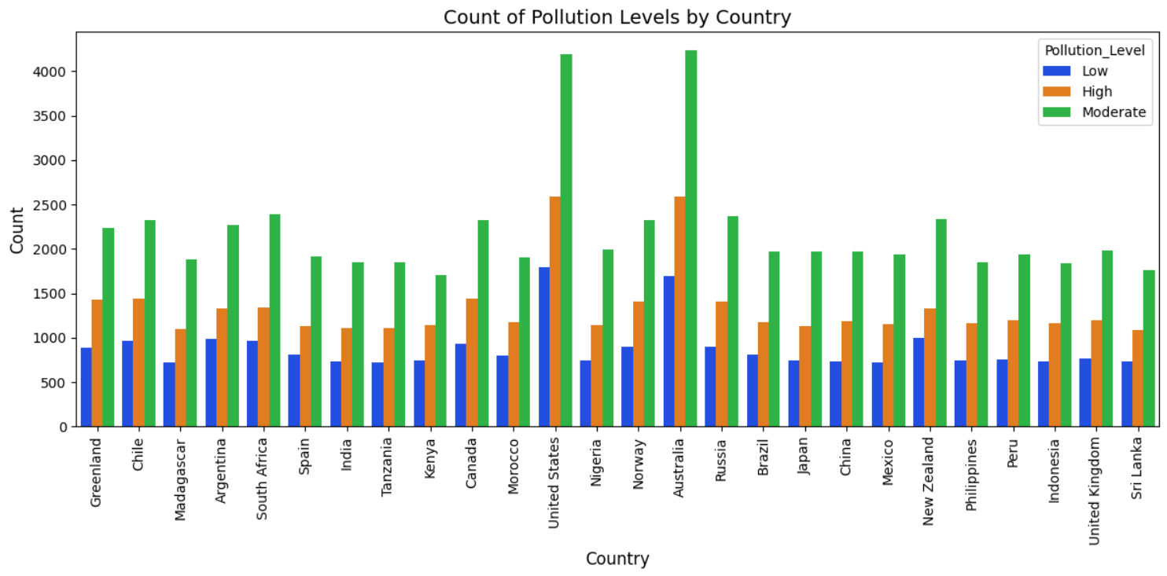
EDA :
This chart shows that moderate pollution is the most common across all countries, but some countries like US and Australia has significantly higher pollution levels. Overall, pollution exists across every country ,highlighting the global nature of the problem

Slide 5
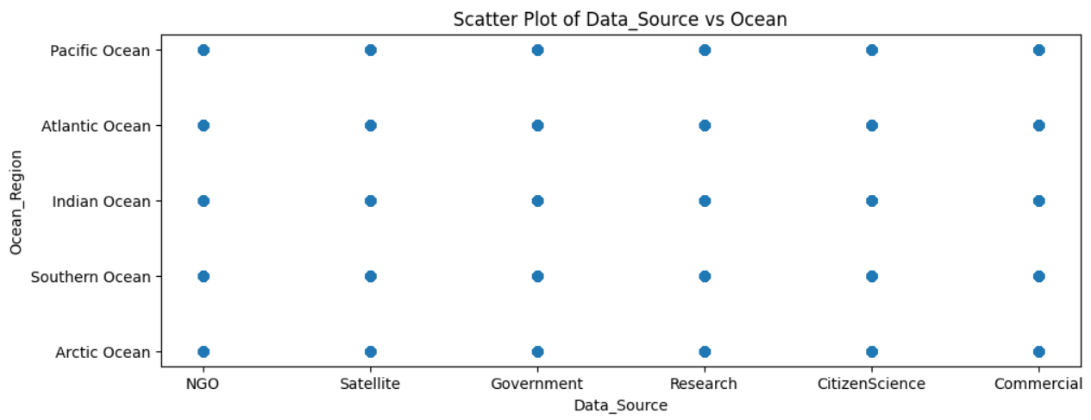
This scatter plot shows the distribution of data collected from difference sources across all ocean region. Each ocean receives contribution form NGOs, satellite, government, research, citizen science, and commercial sources, this indicates good dataset diversity and balanced coverage, improving the reliability of our analysis

Slide 6
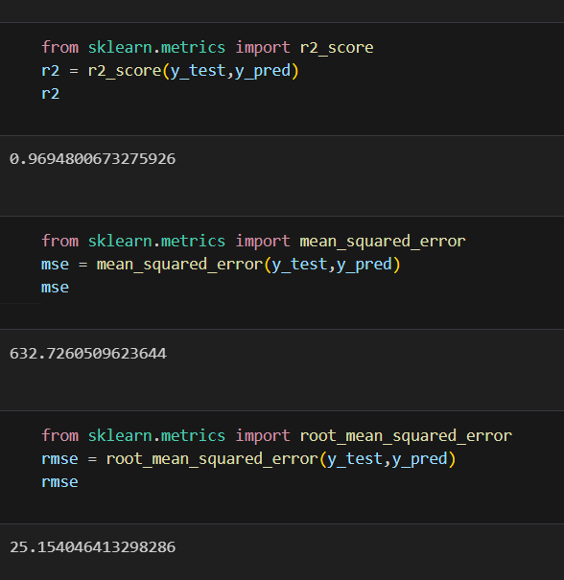
MODEL EVALUATION :
MODEL USED: Linear regression

Slide 7
THANK YOU

